Slide 1
MACHINE LEARNING
UNIT 2

Slide 2

TOPICS TO BE COVERED…
Classification:
Binary Classification- Assessing Classification performance, Class probability Estimation Assessing class probability Estimates, Multiclass Classification.
Regression:
Assessing performance of Regression- Error measures, Overfitting- Catalysts for Overfitting, Case study of Polynomial Regression.
Theory of Generalization:
Effective number of hypothesis, Bounding the Growth function, VC Dimensions, Regularization theory.

Slide 3

WHAT IS CLASSIFICATION?
Classification is a central topic in machine learning that has to do with teaching machines how to group together data by particular criteria.
It is different from regression in the sense that target variables in classification are discrete in nature while in regression they are continuous.
Remember that both regression and classification fall into the category of supervised learning approaches.
There is an also an unsupervised version of the classification, called clustering where computers find shared characteristics by which to group data when categories are not specified (we will encounter it later, not in this concept).

Slide 4

The classification technique or model attempts to get some conclusion from observed values.
In classification problem, we have the categorized output such as “Black” or “white” or “Teaching” and “Non-Teaching”.
While building the classification model, we need to have training dataset that contains data points and the corresponding labels.
For example, if we want to check whether the image is of a car or not.
For checking this, we will build a training dataset having the two classes related to “car” and “no car”.
Then we need to train the model by using the training samples.
The classification models are mainly used in face recognition, spam identification, etc.

Slide 5
BINARY CLASSIFICATION
Binary Classification would generally fall into the domain of Supervised Learning since the training dataset is labelled.
And as the name suggests it is simply a special case in which there are only two classes.
Some typical examples include:
Credit Card Fraudulent Transaction detection
Medical Diagnosis
Spam Detection
Now there are various paradigms that are used for learning binary classifiers which include:
Decision Trees
Neural Networks
Bayesian Classification
Support Vector Machines

Slide 6
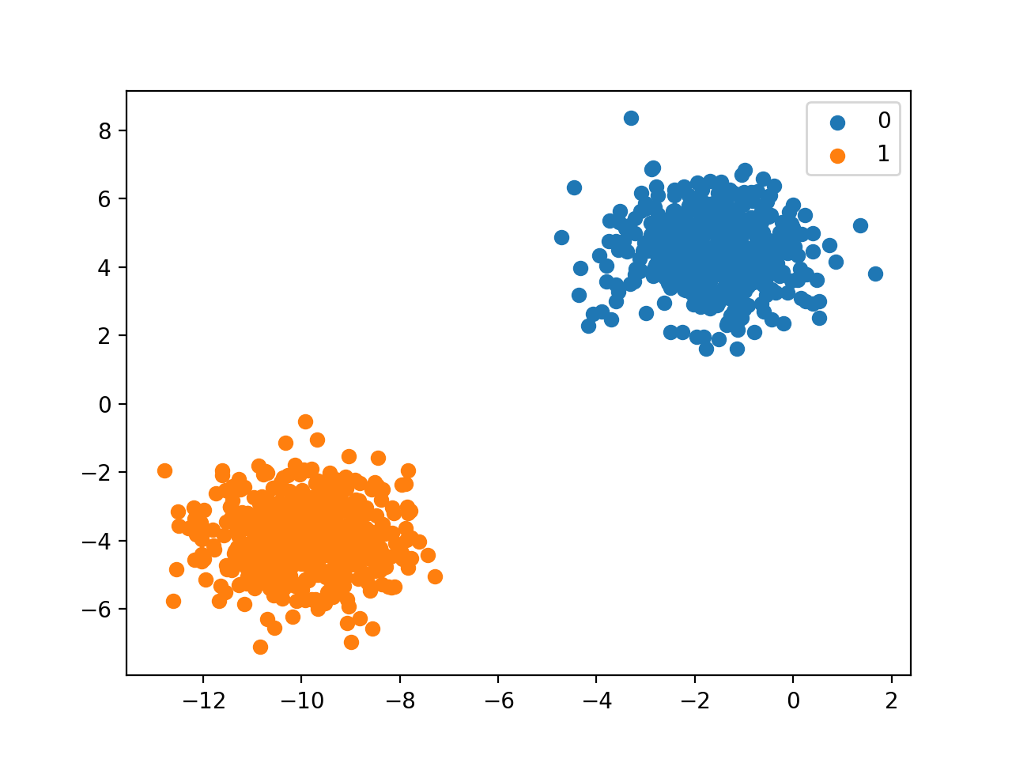
EXAMPLE – BINARY CLASSIFICATION
Typically, binary classification tasks involve one class that is the normal state and another class that is the abnormal state.
For example “not spam” is the normal state and “spam” is the abnormal state. Another example is “cancer not detected” is the normal state of a task that involves a medical test and “cancer detected” is the abnormal state.
The class for the normal state is assigned the class label 0 and the class with the abnormal state is assigned the class label 1.

Slide 7
STEPS TO BUILD A CLASSIFIER USING PYTHON
For building a classifier in Python, we are going to use Python 3 and Scikit-learn which is a tool for machine learning. Follow these steps to build a classifier in Python
Step 1: Import Scikit-learn library
Step 2: Import and load the Dataset
(Identify Features, Target and Data)
Step 3: Organizing data into sets:
(Train, Test Split)
Step 4:Building the model
(Using dedicated Algorithm)
Step 5: Evaluating the model and its accuracy
(Confusion Matrix, Accuracy etc)

Slide 8
ASSESSING CLASSIFICATION PERFORMANCE
After doing the usual Feature Engineering, Selection, and implementing a model and getting some output in forms of a probability or a class, the next step is to find out how effective is the model based on some metric using test datasets.
The performance of classiﬁcation can be summarised by means of a table known as a contingency table or confusion matrix.
Another example of metric for evaluation of machine learning algorithms is Precision, Recall and F1- score.
The metrics that you choose to evaluate your machine learning model is very important.
Choice of metrics influences how the performance of machine learning algorithms is measured and compared.

Slide 9
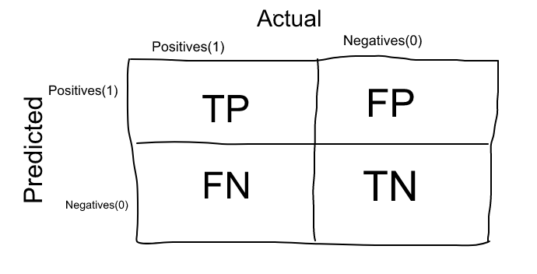
CONFUSION MATRIX
The Confusion matrix is one of the most intuitive and easiest metrics used for finding the correctness and accuracy of the model.
It is used for Classification problem where the output can be of two or more types of classes.
It is the easiest way to measure the performance of a classifier.
A confusion matrix is basically a table with two dimensions namely “Actual” and “Predicted”.
Both the dimensions have “True Positives (TP)”, “True Negatives (TN)”, “False Positives (FP)”, “False Negatives (FN)”.

Slide 10
TERMS ASSOCIATED WITH CONFUSION MATRIX:
True Positives (TP): True positives are the cases when the actual class of the data point was 1(True) and the predicted is also 1(True).
Ex: The case where a person is actually having cancer(1) and the model classifying his case as cancer(1)comes under True positive.
2. True Negatives (TN): True negatives are the cases when the actual class of the data point was 0(False) and the predicted is also 0(False
Ex: The case where a person NOT having cancer and the model classifying his case as Not cancer comes under True Negatives.
3. False Positives (FP): False positives are the cases when the actual class of the data point was 0(False) and the predicted is 1(True). False is because the model has predicted incorrectly and positive because the class predicted was a positive one. (1)
Ex: A person NOT having cancer and the model classifying his case as cancer comes under False Positives.
4. False Negatives (FN): False negatives are the cases when the actual class of the data point was 1(True) and the predicted is 0(False). False is because the model has predicted incorrectly and negative because the class predicted was a negative one. (0)
Ex: A person having cancer and the model classifying his case as No-cancer comes under False Negatives.

Slide 11
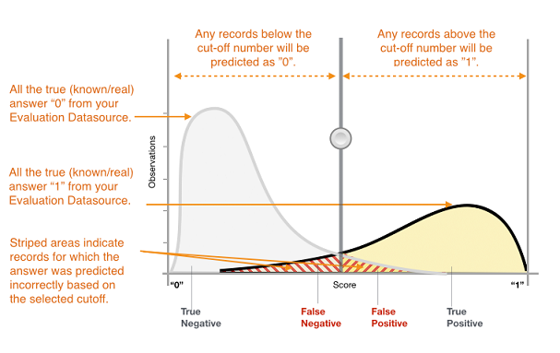
PLOTTING OF CONFUSION MATRIX

Slide 12
HOW DO WE REMEMBER THIS…??
Correct positive predictions (true positives),
Correct negative predictions (true negatives),
Incorrect positive predictions (false positives),
Type 1 error
Incorrect negative predictions (false negatives).
Type 11 error

Slide 13
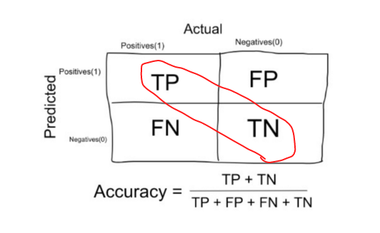
ACCURACY
Accuracy in classification problems is the number of correct predictions made by the model over all kinds predictions made.
In the Numerator, are our correct predictions (True positives and True Negatives)(Marked as red in the fig above)
In the Denominator, are the kind of all predictions made by the algorithm(Right as well as wrong ones).

Slide 14
WHEN TO USE ACCURACY
Accuracy is a good measure when the target variable classes in the data are nearly balanced.
Ex: 60% classes in our fruits images data are apple and 40% are oranges.
A model which predicts whether a new image is Apple or an Orange, 97% of times correctly is a very good measure in this example.
Accuracy should never be used as a measure when the target variable classes in the data are a majority of one class.
Ex: In our cancer detection example with 100 people, only 5 people has cancer.
Let’s say our model is very bad and predicts every case as No Cancer. In doing so, it has classified those 95 non-cancer patients correctly and 5 cancerous patients as Non-cancerous. Now even though the model is terrible at predicting cancer, the accuracy of such a bad model is also 95%.
WHEN NOT TO USE ACCURACY

Slide 15
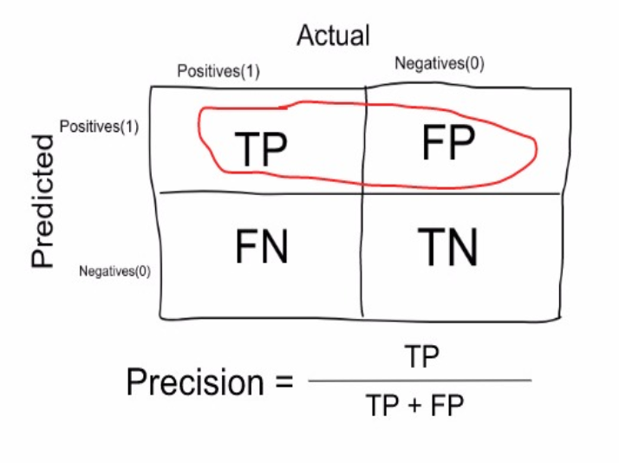
PRECISION
Precision is a measure that tells us what proportion of patients that we diagnosed as having cancer, actually had cancer.
The predicted positives (People predicted as cancerous are TP and FP) and the people actually having a cancer are TP.
Ex: In our cancer example with 100 people, only 5 people have cancer.
Let’s say our model is very bad and predicts every case as Cancer.
Since we are predicting everyone as having cancer, our denominator(True positives and False Positives) is 100 and the numerator, person having cancer and the model predicting his case as cancer is 5. So in this example, we can say that Precision of such model is 5%

Slide 16
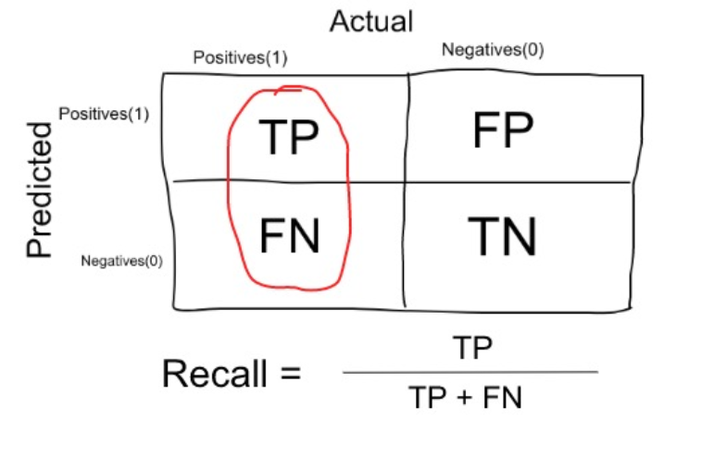
RECALL OR SENSITIVITY
Recall is a measure that tells us what proportion of patients that actually had cancer was diagnosed by the algorithm as having cancer.
The actual positives (People having cancer are TP and FN) and the people diagnosed by the model having a cancer are TP. (Note: FN is included because the Person actually had a cancer even though the model predicted otherwise).
Ex: In our cancer example with 100 people, 5 people actually have cancer. Let’s say that the model predicts every case as cancer.
So our denominator(True positives and False Negatives) is 5 and the numerator, person having cancer and the model predicting his case as cancer is also 5(Since we predicted 5 cancer cases correctly). So in this example, we can say that the Recall of such model is 100%. And Precision of such a model(As we saw above) is 5%

Slide 17
WHEN TO USE PRECISION AND WHEN TO USE RECALL..
It is clear that recall gives us information about a classifier’s performance with respect to false negatives (how many did we miss), while precision gives us information about its performance with respect to false positives(how many did we caught).
Precision is about being precise. So even if we managed to capture only one cancer case, and we captured it correctly, then we are 100% precise.
Recall is not so much about capturing cases correctly but more about capturing all cases that have “cancer” with the answer as “cancer”. So if we simply always say every case as “cancer”, we have 100% recall.
So basically if we want to focus more on minimising False Negatives, we would want our Recall to be as close to 100% as possible without precision being too bad and if we want to focus on minimising False positives, then our focus should be to make Precision as close to 100% as possible.

Slide 18
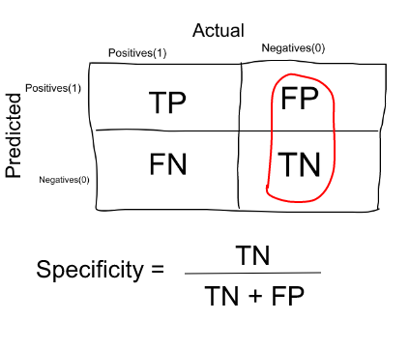
SPECIFICITY
Specificity is a measure that tells us what proportion of patients that did NOT have cancer, were predicted by the model as non-cancerous.
The actual negatives (People actually NOT having cancer are FP and TN) and the people diagnosed by us not having cancer are TN.
(Note: FP is included because the Person did NOT actually have cancer even though the model predicted otherwise).
Specificity is the exact opposite of Recall.
Ex: In our cancer example with 100 people, 5 people actually have cancer. Let’s say that the model predicts every case as cancer.
So our denominator(False positives and True Negatives) is 95 and the numerator, person not having cancer and the model predicting his case as no cancer is 0 (Since we predicted every case as cancer). So in this example, we can that that Specificity of such model is 0%.

Slide 19
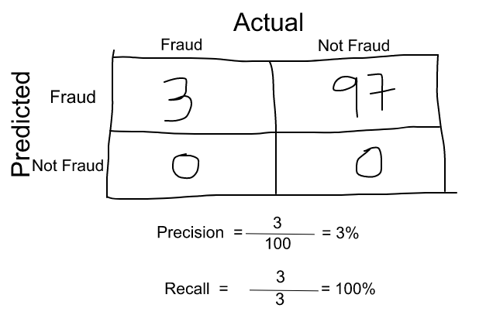
F1 SCORE
We don’t really want to carry both Precision and Recall in our pockets every time we make a model for solving a classification problem. So it’s best if we can get a single score that kind of represents both Precision(P) and Recall(R).
The F₁ score is the harmonic mean of the precision and recall.
One way to do that is simply taking their arithmetic mean. i.e (P + R) / 2 where P is Precision and R is Recall. But that’s pretty bad in some situations.
Suppose we have 100 credit card transactions, of which 97 are legit and 3 are fraud and let’s say we came up a model that predicts everything as fraud.
Now, if we simply take arithmetic mean of both, then it comes out to be nearly 51%. We shouldn’t be giving such a moderate score to a terrible model since it’s just predicting every transaction as fraud.
So, we need something more balanced than the arithmetic mean and that is harmonic mean.

Slide 20
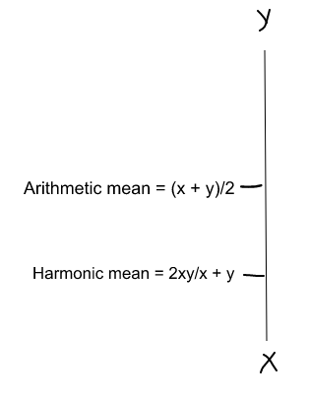
F1 SCORE
The Harmonic mean is given by the formula shown in the figure on the left.
Harmonic mean is kind of an average when x and y are equal. But when x and y are different, then it’s closer to the smaller number as compared to the larger number.
For our previous example, F1 Score = Harmonic Mean(Precision, Recall)
F1 Score = 2 * Precision * Recall / (Precision + Recall)
= 2*3*100/103 = 5%
So, if we were looking to select a model based on a balance between precision and recall, then F1 Score plays an important role.
.

Slide 21
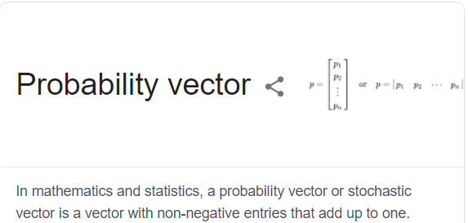
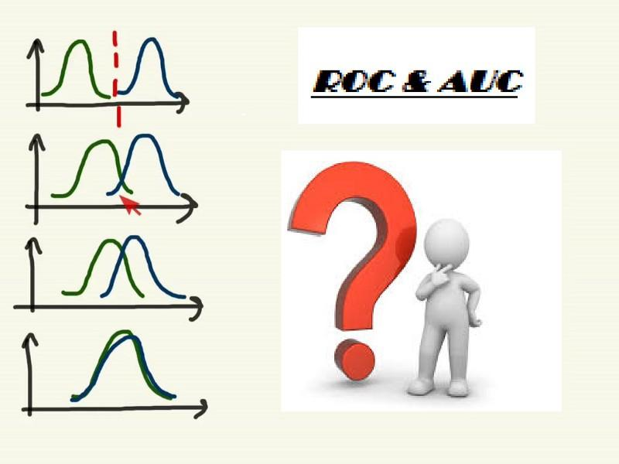
CLASS PROBABILITY ESTIMATION ASSESSING CLASS PROBABILITY ESTIMATES
What is a Class probability Estimation?
A class probability estimator – or probability estimator in short – is a scoring classiﬁer that outputs probability vectors.
If we have only two classes, the probability associated with one class is 1 minus the probability of the other class. It works on the concept of True Positives(TP)
The best way to understand the probability estimates is y understanding the AUC ROC curve.
In simple terms, AUC ROC denotes showing the performance of a binary classification model at various classification thresholds.

Slide 22
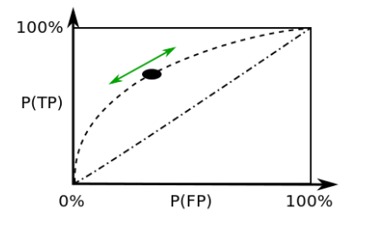
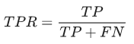
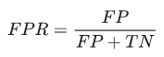
ROC stands for Receiver Operator Characteristic, is a curve that helps us visualize the performance of a binary classifier.
The Area under the curve (AUC) of the ROC curve indicates the ability of the binary classifier to distinguish between both the classes. It is calculated using all possible threshold probabilities, unlike other metrics that use a fixed threshold.
ROC plots 2 Parameters:
1. True Positive Ratio (TPR)
2. False Positive Ratio (FPR)
While we plot the ROC curve, we plot ‘True Positives’ on the Y-axis & ‘False Positives’ on the X-axis.

Slide 23
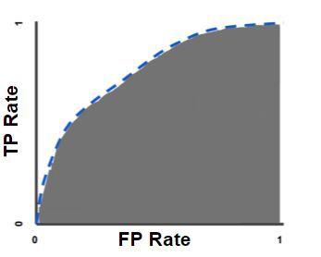
AUC: AREA UNDER THE CURVE
It measures the entire 2Dimensional Area covering X-axis & Y-axis under the ROC curve from (0,0) to (1,1).
AUC helps in providing an aggregate measure of performance across all classification thresholds. Thus AUC ranges in value from 0 to 1.
The model whose predictions are 100% wrong has an AUC of 0.0 while on the same go the model whose predictions are 100% correct has an AUC of 1.0.
Rephrasing the above statement, a very poor classifier has an AUC of around 0.5 & a very good Classifier has an AUC of around 1.

Slide 24
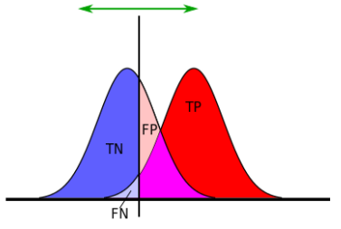
The top left image shows the two distributions of negatives (left side gaussian) and positives (right side gaussian) and the corresponding ROC curve below.
The threshold is the vertical line in the top image. By moving the line from left to right, we obtain different thresholds, calculate the respective TPRs and FPRs and plot it on the ROC curves.
The AUC lies between 0 and 1.

Slide 25
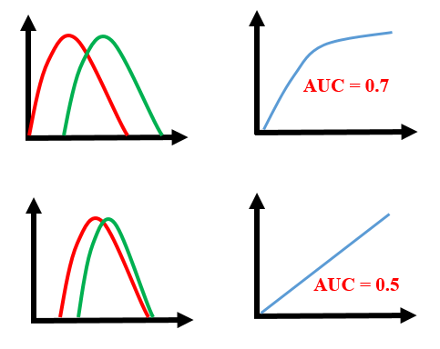

Evaluate your classifier based on the AUC score according to:
.90-1 = excellent classifier
.80-.90 = good classifier
.70-.80 = fair classifier
.60-.70 = poor classifier
.50-.60 = fail classifier
Now let us understand why a low AUC score represents a bad classifier and vice-versa.

Slide 26
Advantages of using AUC score
It is useful even if predicted probabilities are not properly calibrated. For instance, our probabilities may lie in the range (0.8, 0.950.8,0.95). This would have no effect on the AUC score.
Useful metric even if the classes are imbalanced.

Slide 27
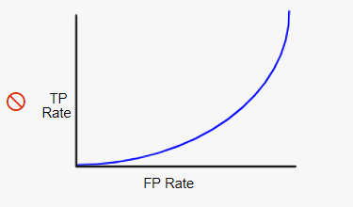
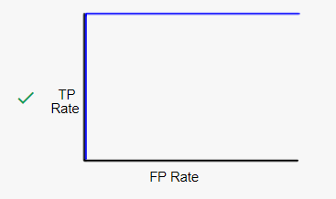
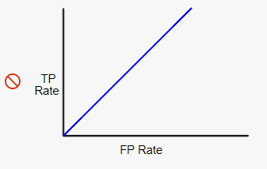
CHECKING THE UNDERSTANDING (ROC AND AUC) VIA PLOTTING
This is the best possible ROC curve, as it ranks all positives above all negatives. It has an AUC of 1.0.
This ROC curve has an AUC between 0 and 0.5, meaning it ranks a random positive example higher than a random negative example less than 50% of the time. The corresponding model actually performs worse than random guessing! If you see an ROC curve like this, it likely indicates there’s a bug in your data.
This ROC curve has an AUC of 0.5, meaning it ranks a random positive example higher than a random negative example 50% of the time. Thus, the corresponding classification model is basically worthless, as its predictive ability is no better than random guessing.

Slide 28
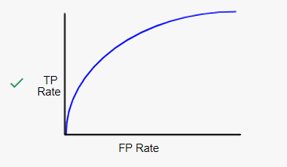
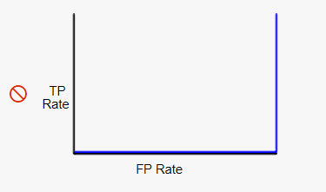
This ROC curve has an AUC between 0.5 and 1.0, meaning it ranks a random positive example higher than a random negative example more than 50% of the time. Real-world binary classification AUC values generally fall into this range.
This is the worst possible ROC curve; it ranks all negatives above all positives, and has an AUC of 0.0. If you were to reverse every prediction (flip negatives to positives and positives to negatives), you’d actually have a perfect classifier!

Slide 29
MULTICLASS CLASSIFICATION
We use binary classifiers to distinguish between any two classes, but what if you'd like to distinguish between more than two?
Multiclass classifiers (also called multinomial classifiers) can distinguish between more than two classes.
Some algorithms (such as Random Forest classifiers or naive Bayes classifiers) are capable of handling multiple classes directly. Others (such as Support Vector Machine classifiers or Linear classifiers) are strictly binary classifiers.
However, there are various strategies that you can use to perform multiclass classification using multiple binary classifiers.
If you'd like to develop a system that classifies images of digit into 12 classes (from 0 to 11) you'll need to train 12 binary classifiers, and make one for every classifier (such as 4–detector, 5-detector, 6-detector and so on), and then you'll need to get the DS, the “decision score,” of every classifier for the image. Then, you'll choose the highest score classifier. We call this the OvA strategy: “one versus-all.”

Slide 30
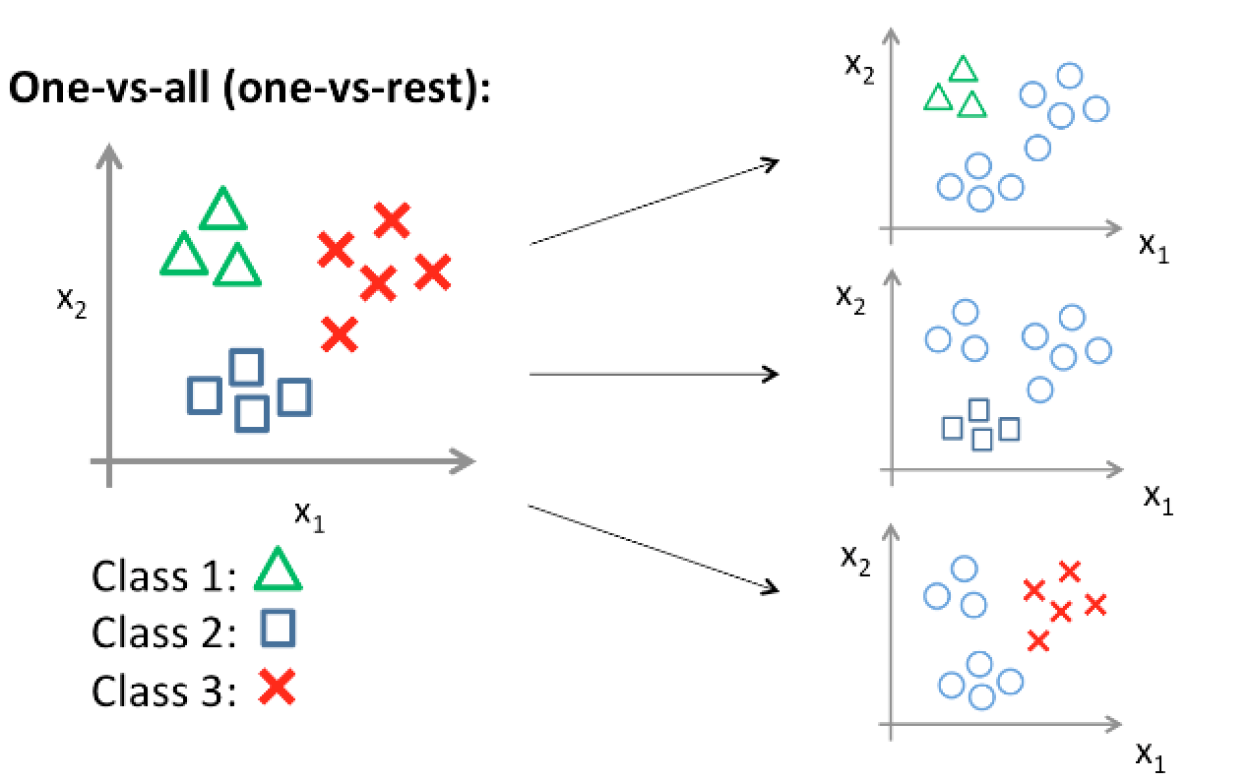
For example, you have a situation at hand to classify shapes like triangles, squares and crosses.
So for this classification problem, you will make 3 logistic classifiers. The first classifier will classify triangles as 1s and the other classes as 0s.
Similarly, the second classifier will classify squares as 1s and other classes as 0s and the third one will classify crosses as 1s and other classes as 0s.
We combine these three classifiers and obtain a single classifier which can now classify shapes into any of the three classes.

Slide 31
The other method is to train a binary classifier for each pair of digits; for example, one for 5s and 6s and another one for 5s and 7s. — we call this method OvO, “one-versus-one”— to count how many classifiers you'll need, based on the number of classes that use the following equation: “N = number of classes”.
N*(N-1)/2
If you'd like to use this technique with the MNIST Dataset, Then 10 * (10-1)/2, the output will be 45 classifiers, “binary classifiers”.

Slide 32
WHAT IS REGRESSION?
Regression is one of the most important statistical and machine learning tools.
We would not be wrong to say that the journey of machine learning starts from regression.
It may be defined as the parametric technique that allows us to make decisions based upon data or in other words allows us to make predictions based upon data by learning the relationship between input and output variables.
Here, the output variables dependent on the input variables, are continuous-valued real numbers.
In regression, the relationship between input and output variables matters and it helps us in understanding how the value of the output variable changes with the change of input variable.
Regression is frequently used for prediction of prices, economics, variations, and so on.

Slide 33
LET US KNOW OUR REGRESSION MORE ..
In simple linear regression, we establish a relationship between the target variable and input variables by fitting a line, known as the regression line.
In general, a line can be represented by linear equation y = mx + b. Where y is the dependent variable, x is the independent variable, m is the slope, b is the intercept.
In machine learning, we rewrite our equation as y(x) = Θ₀ +Θ₁ where Θ_{i’s} are the parameters of the model, x is the input, and y is the target variable. This is the standard notation in machine learning and makes it easier to add more dimensions.
We can simply add variables Θ₂, Θ₃, …Θ_{n} and x₂, x₃ ​… as we add more dimensions. Different values of Θ₀, Θ₁ will give us different lines of fit.
Each of the values of the parameters determine what predictions the model will make. For example, let's consider (Θ₀, Θ₁₎ =(0.0,0.2), and the first data point, where X=3456 and y_{true}​=600.
The prediction made by the model, y(x) = 0.0 + 0.2*3456 = 691.2
If instead the weights were (Θ₀, Θ₁)= (80.0, 0.15) , then the prediction would be y(x)=80.0+0.15∗3456=598.4, which is much closer to the y_{true}=600.

Slide 34
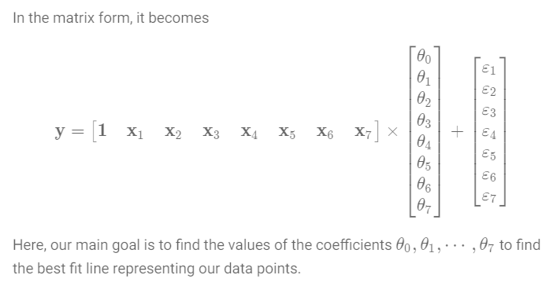
This difference between the actual value of the target and the predicted value is called the residual.
You should always select the line with the least residual as the line fits the data points appropriately.
To put it more formally the residual ε = y_{true} – y_{pred.}

Slide 35
ASSESSING PERFORMANCE OF REGRESSION- ERROR MEASURES
When we train the model and have fitted your model on training data, it is time to test it on unseen data. You also need to have some kind of measure to quantify the performance of the model.
This measure is captured by what we call the error metrics and there are many different forms depending on the problem statement.
We have a regression problem at hand and the different types of error metrics that can be used are:
Mean Absolute Error (MAE)
Root Mean Squared Error (RMSE)
R-Squared

Slide 36

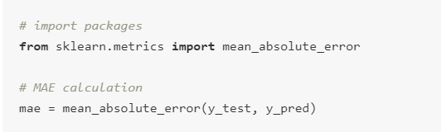
MEAN ABSOLUTE ERROR (MAE)
So we already know what a residual is. To recap, it is the difference between our prediction and the true value. Mean absolute error is nothing but the average of absolute values of these residuals. We can write a simple formula for Mean Absolute Error (MAE) as follows.
Calculating MAE with scikit-learn
Scikit-learn provides a very easy way to calculate MAE. The code snippet is shown below:

Slide 37
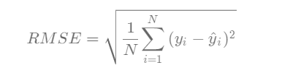
ROOT MEAN SQUARE ERROR
Root mean Square Error (RMSE) is nothing but the square root of the mean/average of the squares of all the errors.
RMSE is very commonly used and makes for an excellent general purpose error metric for numerical predictions.
Compared to the similar Mean Absolute Error, RMSE amplifies and severely punishes large errors.
If y_{i}​ are the actual values and ŷ_{i} are the predicted values then,

Slide 38
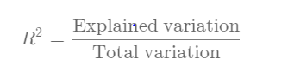
R-SQUARED
R-squared is a statistical measure of how close the data are to the fitted regression line i.e. it measures the goodness of fit of a straight line. It is also known as the coefficient of determination, or the coefficient of multiple determination for multiple regression.
It is a measure of the proportion of variability in the response that is explained by the regression model. Mathematically,

Slide 39
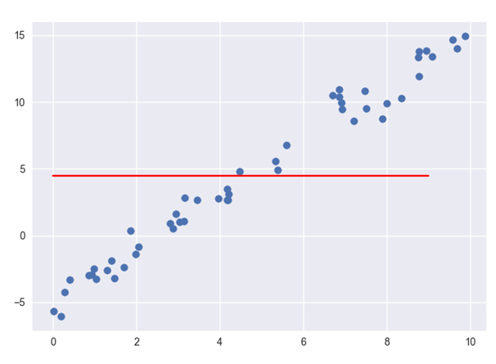
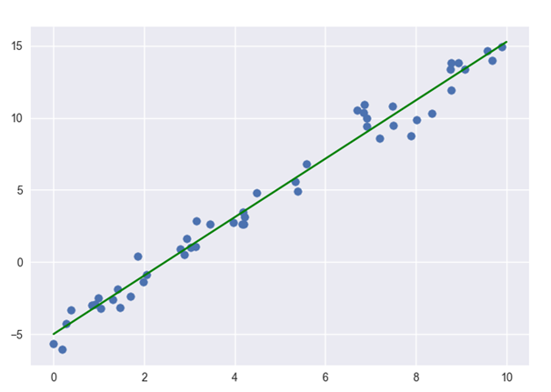
R-squared is always between 0 and 100%:
0 % indicates that the model explains none of the variability of the response data around its mean.
100% indicates that the model explains all the variability of the response data around its mean.

Slide 40
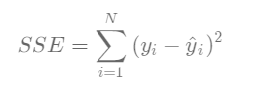
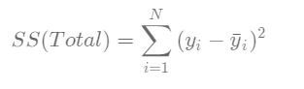
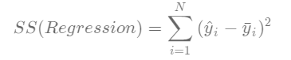
MATHEMATICAL INTUITION BEHIND R²
Before we get into calculating R², let's understand what the different Sum of Squares for our model are:
In RMSE, we have already been introduced to Squared Residuals which is also called Error Sum of Squares (SSE)
R-squared simply explains how good is your model when compared to this baseline model.
And we also have Regression Sum of Squares, which is the squared difference between the Predicted values (ŷ_{i}) and the Mean (ȳ_{i})

Slide 41
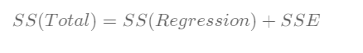
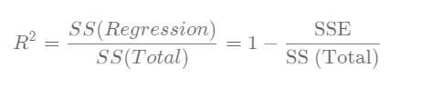
Now, intuitively, we can see that:
Thus R² is defined as:
Pitfalls of R-squared
R-squared can be made artificially high by adding more number of independent variables although they might be irrelevant. These features enable the model to learn more. As a result, the model will fit the data points better or will remain the same; resulting in the increased value of R-squared or remaining the same.
R-squared cannot determine whether the coefficient estimates and predictions are biased, which is why you must assess the residual plots.

Slide 42
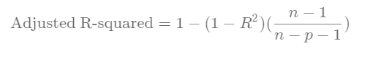
Adjusted R-squared
To counter the issue of adding more independent variables, you should consider using the metric Adjusted R-squared instead of R-squared. Simply put it penalizes the model for adding irrelevant explanatory variables. Mathematically,
where
n = Number of data points
p = Number of explanatory/independent variables
So how is R-squared different from Adjusted R-squared?
R-squared tells you how well your model fits the data points whereas Adjusted R-squared tells you how important is a particular feature to your model.

Slide 43
OVERFITTING- CATALYSTS FOR OVERFITTING
We will understand both Underfitting and Overfitting as they are important hand in hand.
Let us consider that we are designing a machine learning model. A model is said to be a good machine learning model if it generalizes any new input data from the problem domain in a proper way. This helps us to make predictions in the future data, that data model has never seen.
Now, suppose we want to check how well our machine learning model learns and generalizes to the new data. For that we have overfitting and underfitting, which are majorly responsible for the poor performances of the machine learning algorithms.
Before diving further let’s understand two important terms:
Bias – Assumptions made by a model to make a function easier to learn.
Variance – If you train your data on training data and obtain a very low error, upon changing the data and then training the same previous model you experience high error, this is variance.

Slide 44
Underfitting
A statistical model or a machine learning algorithm is said to have underfitting when it cannot capture the underlying trend of the data. (It’s just like trying to fit undersized pants!)
Underfitting destroys the accuracy of our machine learning model.
Its occurrence simply means that our model or the algorithm does not fit the data well enough.
It usually happens when we have less data to build an accurate model and also when we try to build a linear model with a non-linear data.
In such cases the rules of the machine learning model are too easy and flexible to be applied on such minimal data and therefore the model will probably make a lot of wrong predictions.
Underfitting can be avoided by using more data and also reducing the features by feature selection.
In a nutshell, Underfitting – High bias and low variance

Slide 45
Techniques to reduce underfitting :
1. Increase model complexity 2. Increase number of features, performing feature engineering 3. Remove noise from the data. 4. Increase the number of epochs or increase the duration of training to get better results.

Slide 46
Overfitting:
A statistical model is said to be overfitted, when we train it with a lot of data (just like fitting ourselves in oversized pants!).
When a model gets trained with so much of data, it starts learning from the noise and inaccurate data entries in our data set.
Then the model does not categorize the data correctly, because of too many details and noise.
The causes of overfitting are the non-parametric and non-linear methods because these types of machine learning algorithms have more freedom in building the model based on the dataset and therefore they can really build unrealistic models.
A solution to avoid overfitting is using a linear algorithm if we have linear data or using the parameters like the maximal depth if we are using decision trees.
In a nutshell, Overfitting – High variance and low bias

Slide 47
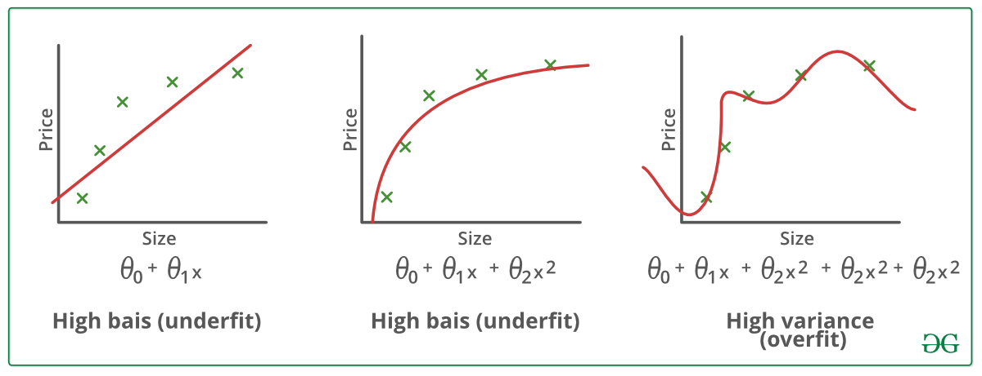

EXAMPLE

Slide 48
Techniques to reduce overfitting :
1. Increase training data. 2. Reduce model complexity. 3. Early stopping during the training phase (have an eye over the loss over the training period as soon as loss begins to increase stop training). 4. Ridge Regularization and Lasso Regularization 5. Use dropout for neural networks to tackle overfitting.

Slide 49
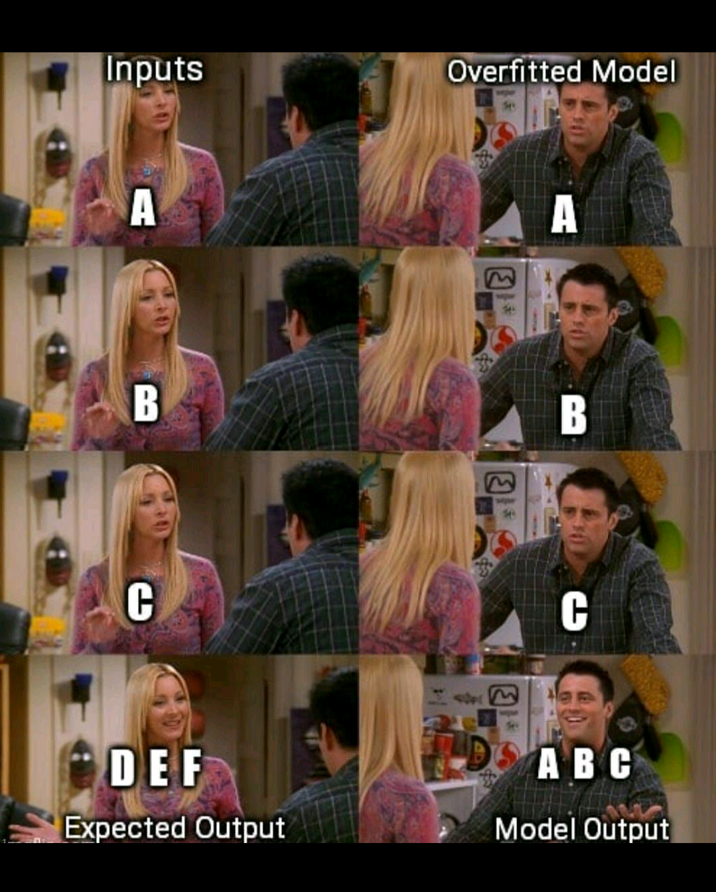

Slide 50
CASE STUDY OF POLYNOMIAL REGRESSION.
What is Polynomial Regression?
Polynomial regression is a special case of linear regression where we fit a polynomial equation on the data with a curvilinear relationship between the target variable and the independent variables.
In a curvilinear relationship, the value of the target variable changes in a non-uniform manner with respect to the predictor (s).
Polynomial regression is a special case of linear regression. It’s based on the idea of how to your select your features. Looking at the multivariate regression with 2 variables: x1 and x2. Linear regression will look like this:
y = a1 * x1 + a2 * x2.
Now you want to have a polynomial regression (let’s make 2-degree polynomial). We will create a few additional features: x1*x2, x1^2 and x2^2. So we will get your ‘linear regression’:
y = a1 * x1 + a2 * x2 + a3 * x1*x2 + a4 * x1^2 + a5 * x2^2

Slide 51
A polynomial term: a quadratic (squared) or cubic (cubed) term turns a linear regression model into a curve.
But because it is the data X that is squared or cubed, it still qualifies as a linear model.
This makes it a nice and straightforward way to model curves without having to model complicated nonlinear models.
Problem Statement:
To understand the relationship between the degree of the independent variable and the dependent variable.
We take a dataset to understand this perfectly.

Slide 52
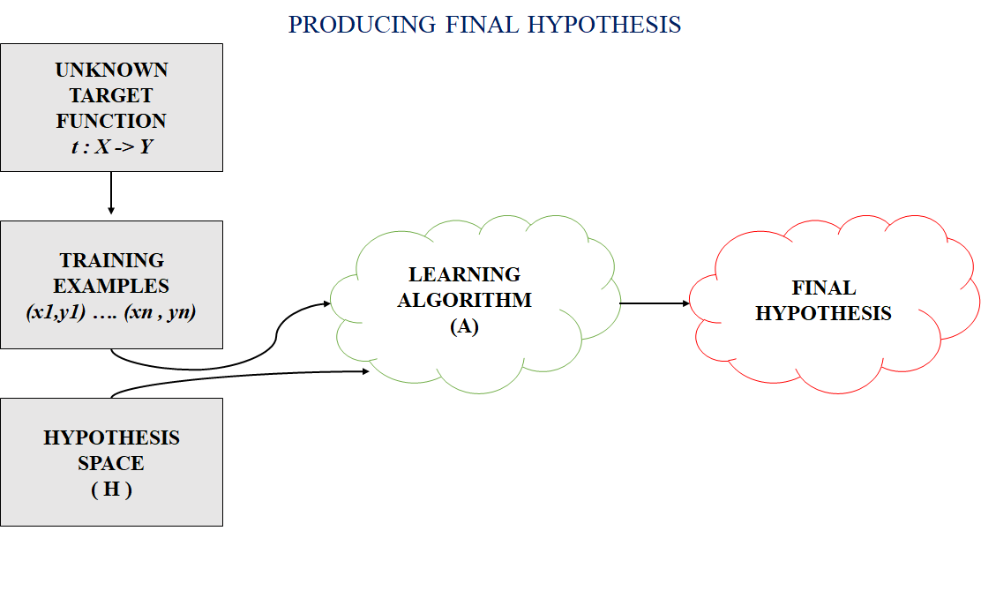
THEORY OF GENERALIZATION: HYPOTHESIS
In most supervised machine learning algorithm, our main goal is to find out a possible hypothesis from the hypothesis space that could possibly map out the inputs to the proper outputs.
The following figure shows the common method to find out the possible hypothesis from the Hypothesis space:

Slide 53


Slide 54
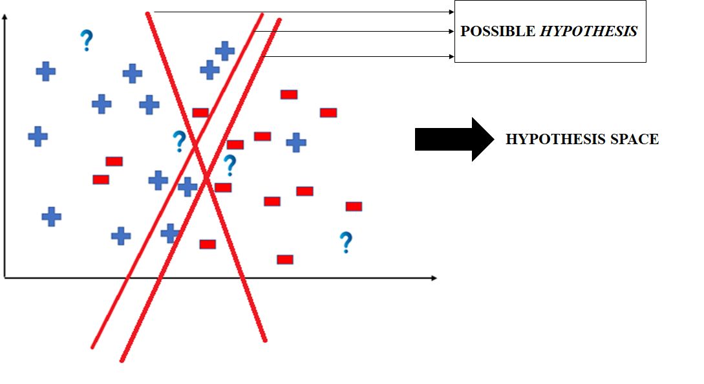
Hypothesis Space (H): Hypothesis space is the set of all the possible legal hypothesis. This is the set from which the machine learning algorithm would determine the best possible (only one) which would best describe the target function or the outputs.
Hypothesis (h): A hypothesis is a function that best describes the target in supervised machine learning. The hypothesis that an algorithm would come up depends upon the data and also depends upon the restrictions and bias that we have imposed on the data.

Slide 55
Let us now take a closer look into understanding what exactly a hypothesis is and a brief about the process of conduction a hypothesis test.
Hypothesis is a statement about the population that might be true. The beauty of these Hypotheses is that they can be TESTED!
Example: We have a hypothesis that the 'the average salary of the Data Scientists in the Bay Area and Montreal is different'.
Statistical hypothesis tests are based on a statement called the null hypothesis that assumes nothing interesting is going on between whatever variables you are testing.
Therefore, in our case, the Null Hypothesis is that 'The average salary of Data Scientists in the Bay Area and Montreal is same'
The purpose of a hypothesis test is to determine whether the null hypothesis is likely to be true given sample data.
If there is little evidence against the null hypothesis given the data, you accept the null hypothesis.
If the null hypothesis is unlikely given the data, you might reject the null in favor of the alternative hypothesis: that something interesting is going on.

Slide 56
Alternate Hypothesis:
This is nothing but the question you ask which kind of "opposes" the Null Hypothesis.
Therefore, in our case the Alternative Hypothesis is that: "The average salary of Data Scientists in Bay Area and Montreal is different“.
Only 1 Hypothesis out of Null and Alternate can be right.
In hypothesis testing, we test a sample, with the goal of accepting or rejecting a null hypothesis which is our assumption or the default position.
The test tells us whether or not our primary hypothesis is true.
Important: The null hypothesis is assumed true and statistical evidence is required to reject it in favor of an alternative hypothesis.

Slide 57
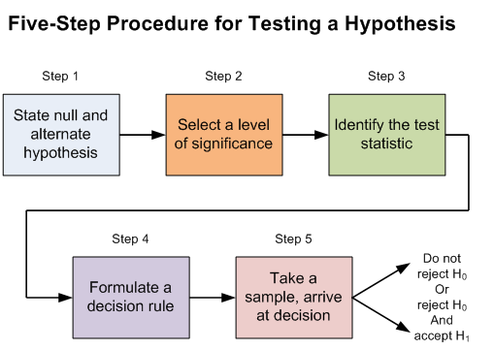

Slide 58


